Slide 1
Overall parameter (12-05-2019)
File created on: 12/5/2019 2:46:41 PM

Slide 2
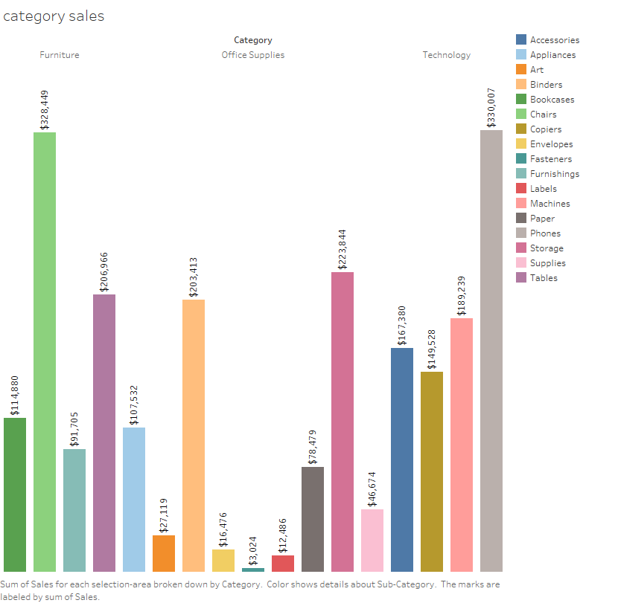

Slide 3
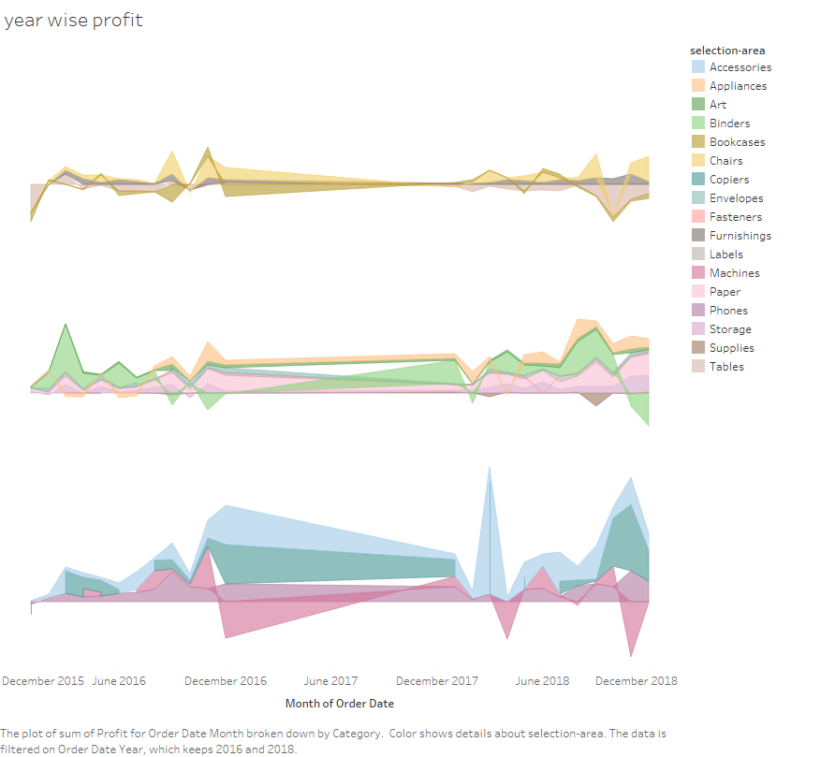

Slide 4


Slide 5
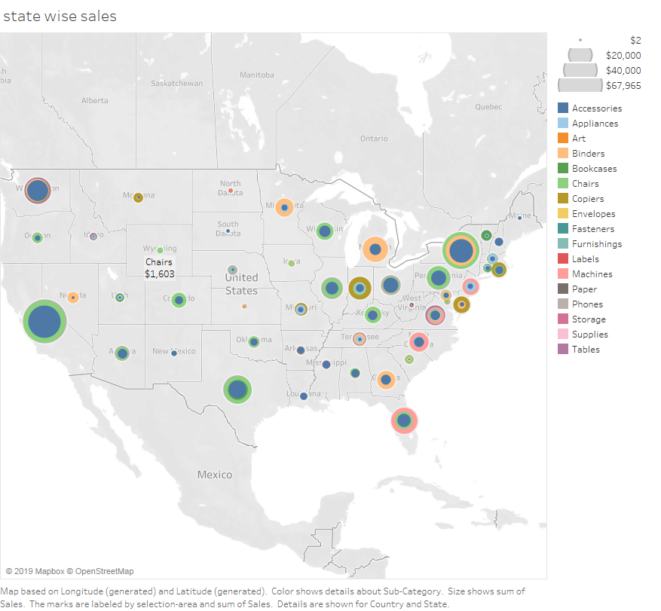

Slide 6
